Slide 1
Royan Shopee
Deal With Best

Slide 2

Landing Page

Slide 3
Landing Page
HTML Tags Used:
➜ Div, ul, li, h1,h2
CSS Tags Used:
➜ Padding, Margin, hover, color, font-family, Transition, Background.

Slide 4
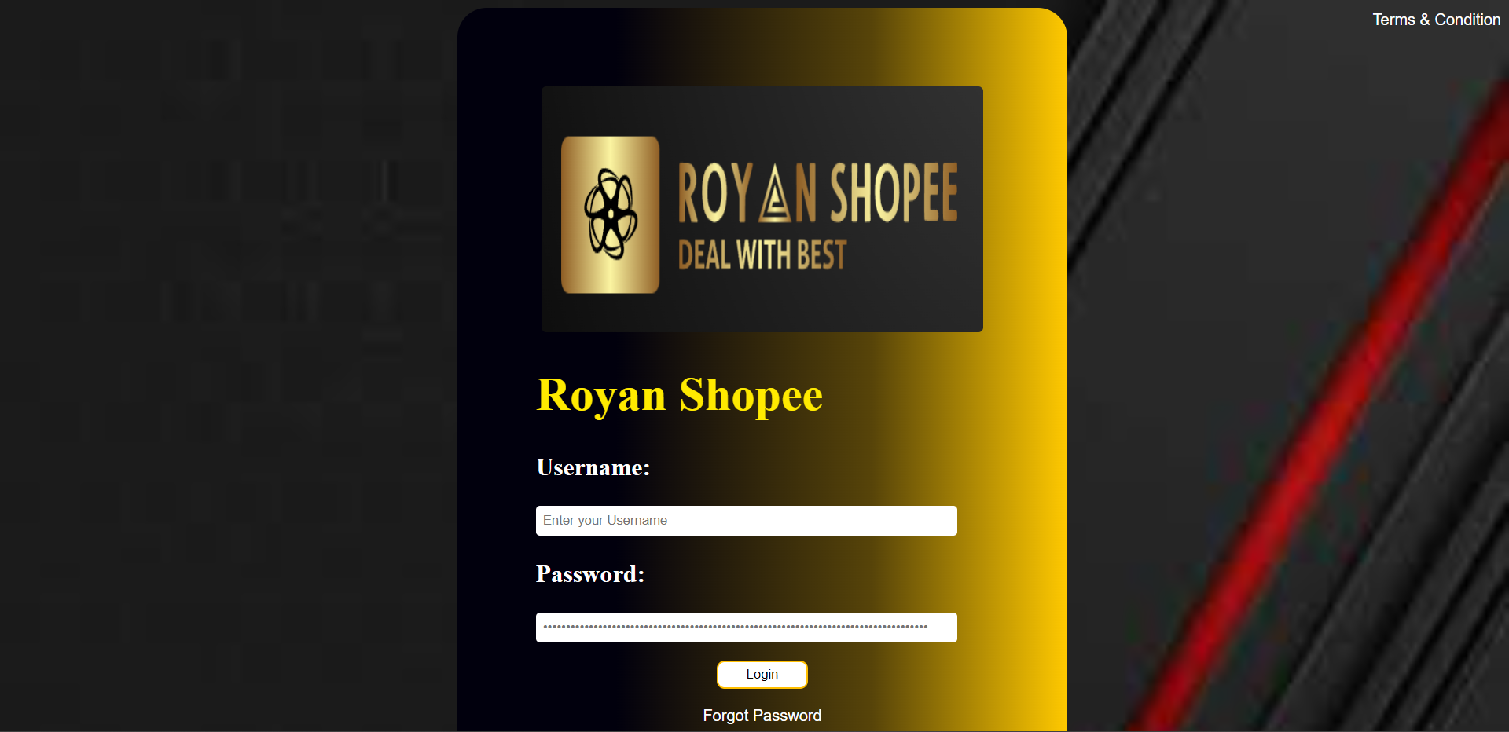
Login Page

Slide 5
Login Page
HTML Tags Used:
➜ Div, h1,p, a href, input.
CSS Tags Used:
➜ Padding, Margin, hover, color, font-family, Transition, Background, Border-style, border-radius.

Slide 6
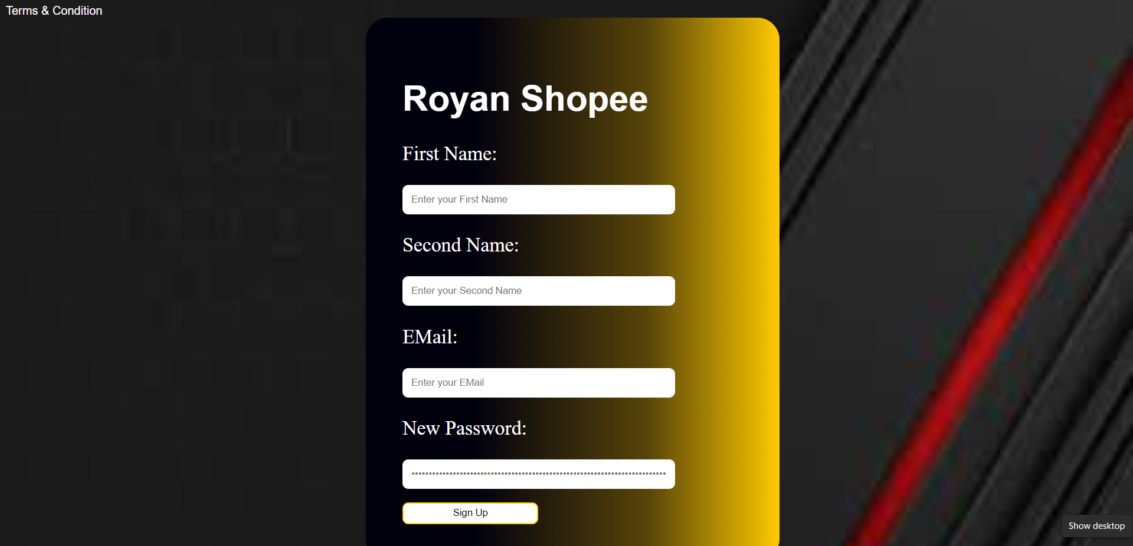
Sign Up Page

Slide 7
Sign Up Page
HTML Tags Used:
➜ Div, h1,p, a href, input.
CSS Tags Used:
➜ Padding, Margin, hover, color, font-family, Transition, Background, Border-style, border-radius.

Slide 8
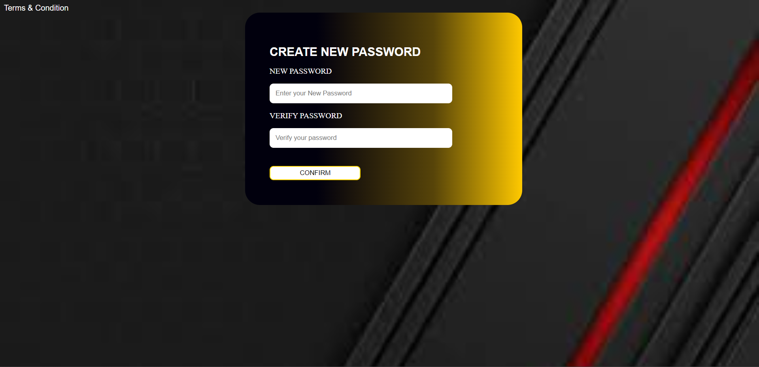
Forgot Password Page

Slide 9
Forgot Password Page
HTML Tags Used:
➜ Div, h1,p, a href, input.
CSS Tags Used:
➜ Padding, Margin, hover, color, font-family, Transition, Background, Border-style, border-radius.

Slide 10

About Us Page

Slide 11
About Us Page
HTML Tags Used:
➜ style, h1, h2, break.
CSS Tags Used:
➜ Background, height, width, overflow.

Slide 12
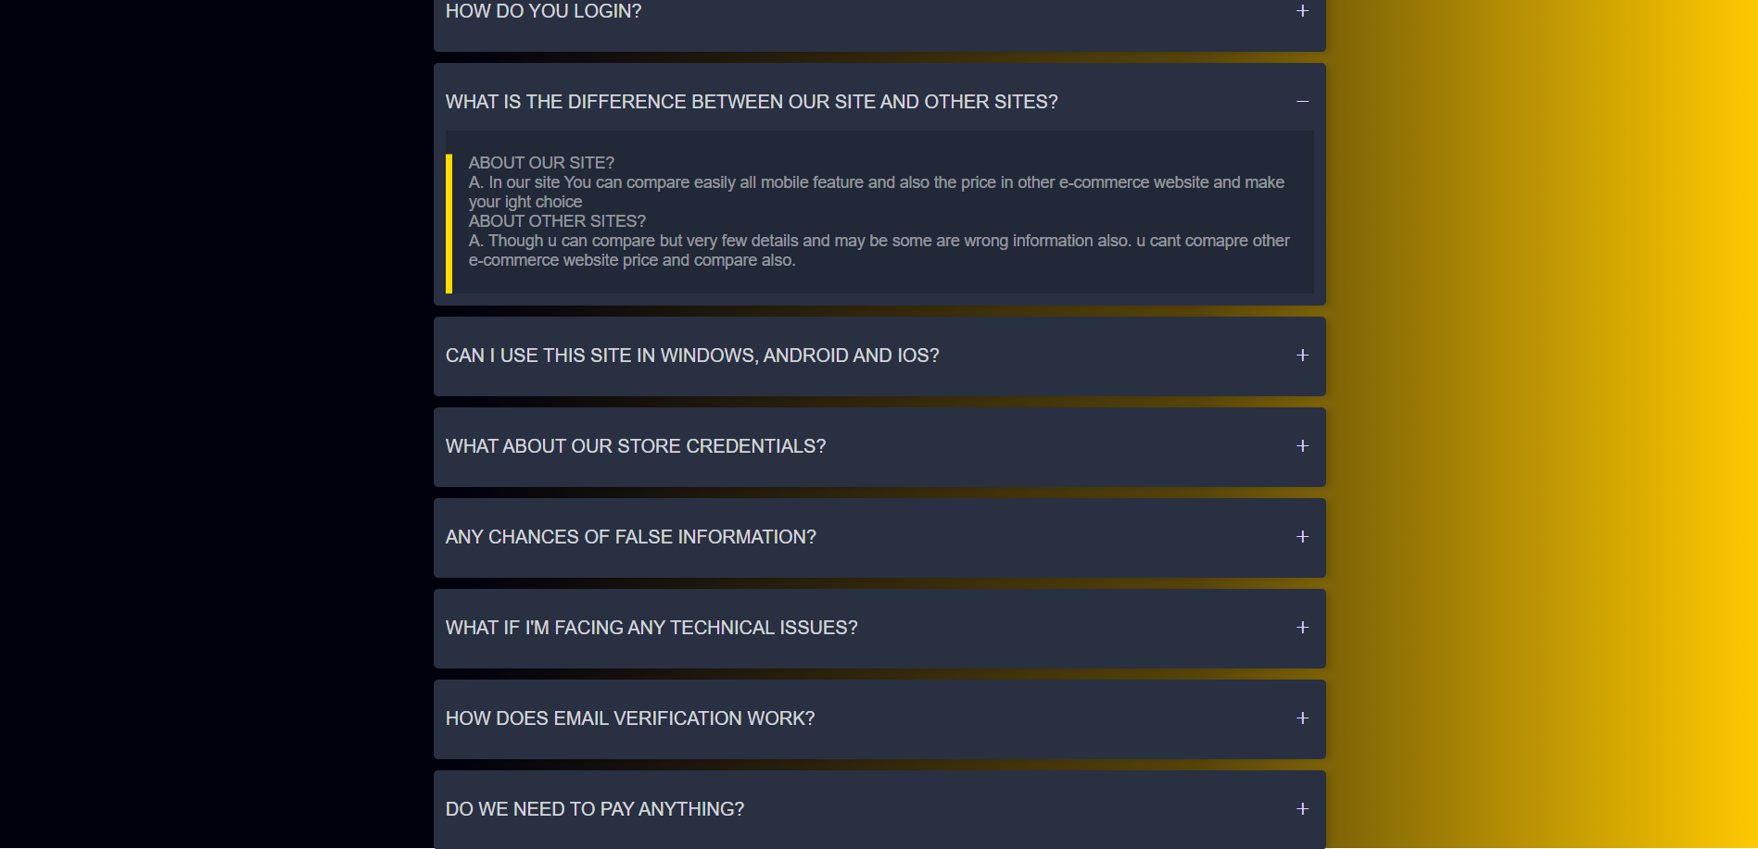
FAQ Page

Slide 13
FAQ Page
HTML Tags Used:
➜ Div, a href, p, selection
CSS Tags Used:
➜ Padding, Margin, hover, color, font-family, Box-Sizing, Justify-content, Background, Border-style, border-radius.

Slide 14

Home Page

Slide 15
Home Page
HTML Tags Used:
➜ Div, a href, h1, h4, td, tr, style
CSS Tags Used:
➜ Padding, Box-shadow, hover, color, font-family, Box-Sizing, Transition, Background, Border-style, border-radius.

Slide 16
Thank You

